Slide 1
Decidable Languages
Costas Busch - LSU

Slide 2


Recall that:
A language is Turing-Acceptable
if there is a Turing machine
that accepts
Also known as: Turing-Recognizable
or
Recursively-enumerable
languages
Costas Busch - LSU

Slide 3



Turing-Acceptable
For any input string :
halts in an accept state
halts in a non-accept state
or loops forever
Costas Busch - LSU

Slide 4

Definition:
A language is decidable
if there is a Turing machine (decider)
which accepts
and halts on every input string
Also known as recursive languages
Costas Busch - LSU

Slide 5
Turing-Decidable
For any input string :
halts in an accept state
halts in a non-accept state
Observation:
Every decidable language is Turing-Acceptable
Costas Busch - LSU

Slide 6
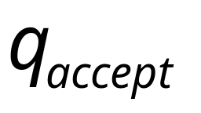
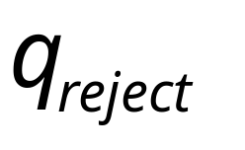
Sometimes, it is convenient to have Turing
machines with single accept and reject states
These are the only halting states
That result to possible
halting configurations
Costas Busch - LSU

Slide 7



We can convert any Turing machine to
have single accept and reject states
New machine
Old machine
For each tape symbol
Multiple
accept states
One accept state
Costas Busch - LSU

Slide 8



Do the following for each possible
halting state:
New machine
Old machine
For each
For all tape symbols
not used for read in the
other transitions of
Multiple
reject states
One reject state
Costas Busch - LSU

Slide 9

For a decidable language :
Decision
On Halt:
Decider for
Accept
Input
string
Reject
For each input string, the computation
halts in the accept or reject state
Costas Busch - LSU

Slide 10
For a Turing-Acceptable language :
Turing Machine for
Input
string
It is possible that for some input string
the machine enters an infinite loop
Costas Busch - LSU

Slide 11
A computational problem is decidable
if the corresponding language is decidable
We also say that the problem is solvable
Costas Busch - LSU

Slide 12

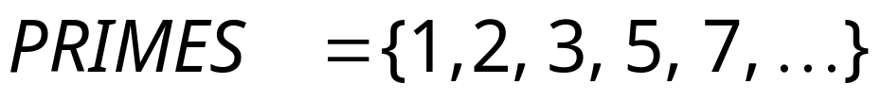
Problem:
Is number prime?
Corresponding language:
We will show it is decidable
Costas Busch - LSU

Slide 13
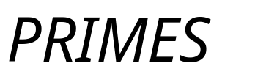
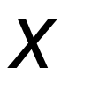
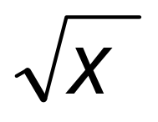

Decider for :
On input number :
Divide with all possible numbers
between and
If any of them divides
Then reject
Else accept
Costas Busch - LSU

Slide 14

the decider Turing machine can be designed
based on the algorithm
Decider for PRIMES
YES
Input number
is prime?
(Accept)
(Input string)
NO
(Reject)
Costas Busch - LSU

Slide 15

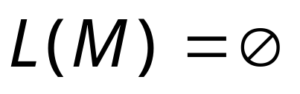

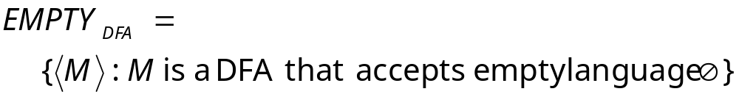

Problem:
Does DFA accept
the empty language ?
Corresponding Language:
(Decidable)
Description of DFA as a string
(For example, we can represent as a
binary string, as we did for Turing machines)
Costas Busch - LSU

Slide 16
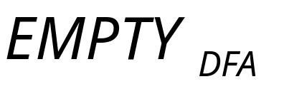
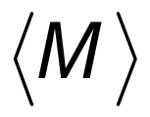

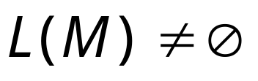

Decider for :
On input :
Determine whether there is a path from
the initial state to any accepting state
DFA
DFA
Decision:
Reject
Accept
Costas Busch - LSU

Slide 17
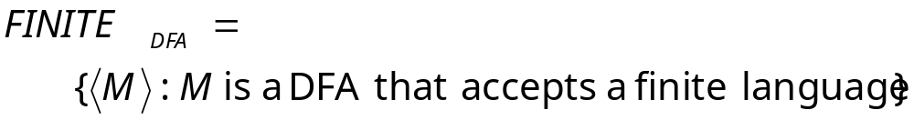
Problem:
Does DFA accept
a finite language?
Corresponding Language:
(Decidable)
Costas Busch - LSU

Slide 18
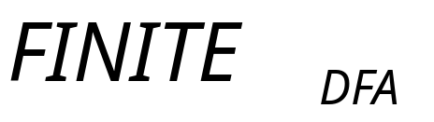
Decider for :
On input :
Check if there is a walk with a cycle
from the initial state to an accepting state
DFA
DFA
infinite
finite
Decision:
Reject
Accept
(NO)
(YES)
Costas Busch - LSU

Slide 19

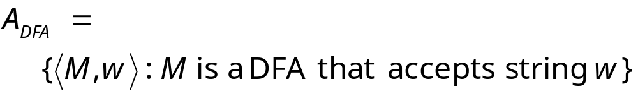
Problem:
Does DFA accept string ?
Corresponding Language:
(Decidable)
Costas Busch - LSU

Slide 20
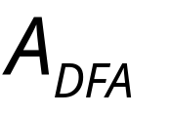
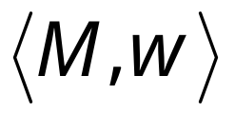
Decider for :
On input string :
Run DFA on input string
If accepts
Then accept (and halt)
Else reject (and halt)
Costas Busch - LSU

Slide 21
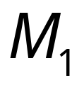
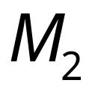
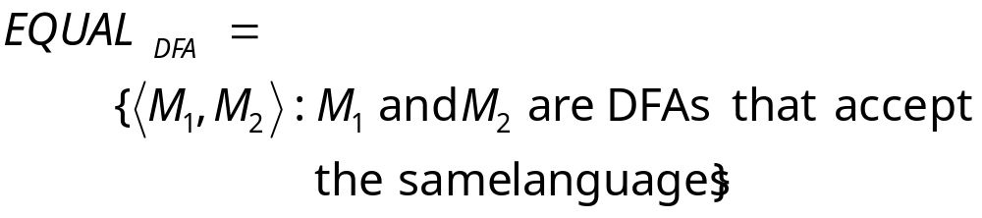
Problem:
Do DFAs and
accept the same language?
Corresponding Language:
(Decidable)
Costas Busch - LSU

Slide 22
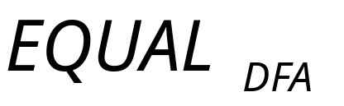
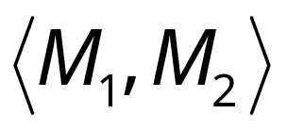

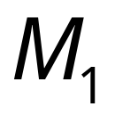

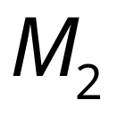

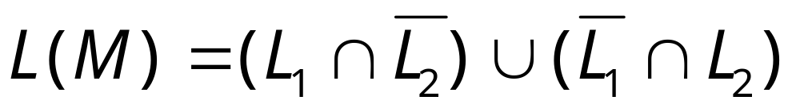
Decider for :
On input :
Let be the language of DFA
Let be the language of DFA
Construct DFA such that:
(combination of DFAs)
Costas Busch - LSU

Slide 23
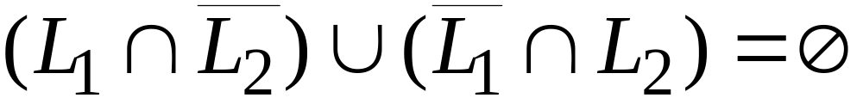
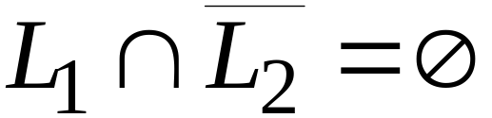
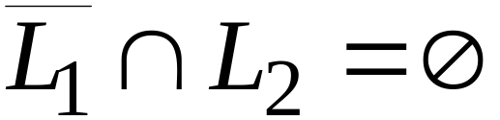


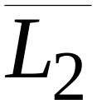
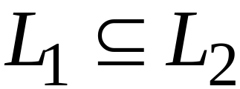
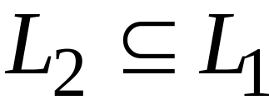
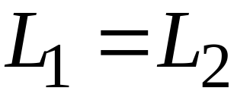
and
Costas Busch - LSU

Slide 24
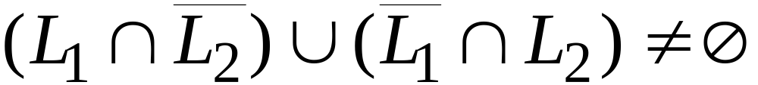
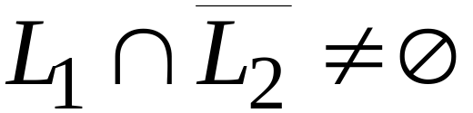
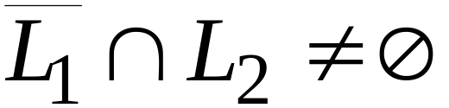
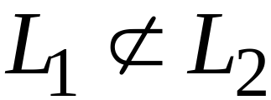
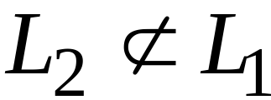
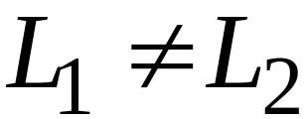
or
Costas Busch - LSU

Slide 25
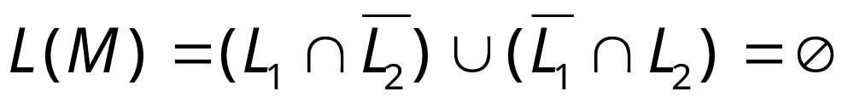
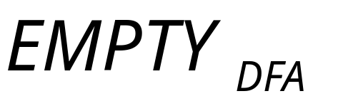
Therefore, we only need
to determine whether
which is a solvable problem for DFAs:
Costas Busch - LSU

Slide 26



Theorem:
If a language is decidable,
then its complement is decidable too
Proof:
Build a Turing machine that
accepts and halts on every input string
( is decider for )
Costas Busch - LSU

Slide 27



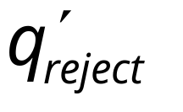
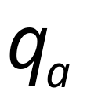

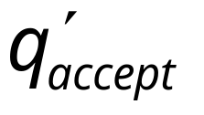

Transform accept state to reject
and vice-versa
Costas Busch - LSU

Slide 28



Turing Machine
On each input string do:
1. Let be the decider for
2. Run with input string
If accepts then reject
If rejects then accept
Accepts and halts on every input string
END OF PROOF
Costas Busch - LSU

Slide 29
Undecidable Languages
Costas Busch - LSU

Slide 30
Undecidable Languages
An undecidable language has no decider:
Any Turing machine that accepts
does not halt on some input string
We will show that:
There is a language which is
Turing-Acceptable and undecidable
Costas Busch - LSU

Slide 31
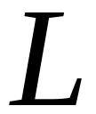
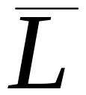
We will prove that there is a language :
is Turing-acceptable
is not Turing-acceptable
(not accepted by any Turing Machine)
the complement of a
decidable language is decidable
Therefore, is undecidable
Costas Busch - LSU

Slide 32
Non Turing-Acceptable
Turing-Acceptable
Decidable
Costas Busch - LSU

Slide 33
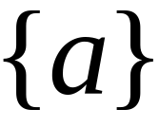
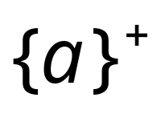

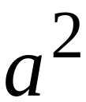
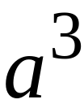
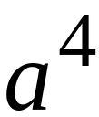
Consider alphabet
Strings of :
Costas Busch - LSU

Slide 34
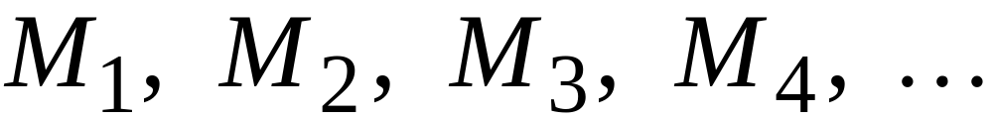
Consider Turing Machines
that accept languages over alphabet
They are countable:
(There is an enumerator that generates them)
Costas Busch - LSU

Slide 35


Each machine accepts some language over
Note that it is possible to have
for
Since, a language could be accepted by more than one
Turing machine
Costas Busch - LSU

Slide 36













Example language accepted by
Binary representation
Costas Busch - LSU

Slide 37




Example of binary representations
Costas Busch - LSU

Slide 38

Consider the language
consists of the 1’s in the diagonal
Costas Busch - LSU

Slide 39

Costas Busch - LSU

Slide 40



Consider the language
consists of the 0’s in the diagonal
Costas Busch - LSU

Slide 41

Costas Busch - LSU

Slide 42


Theorem:
Language is not Turing-Acceptable
Proof:
Assume for contradiction that
is Turing-Acceptable
Let be the Turing machine
that accepts :
Costas Busch - LSU

Slide 43


Question:
Costas Busch - LSU

Slide 44


Answer:
Costas Busch - LSU

Slide 45

Question:
Costas Busch - LSU

Slide 46


Answer:
Costas Busch - LSU

Slide 47

Question:
Costas Busch - LSU

Slide 48


Answer:
Costas Busch - LSU

Slide 49




Similarly:
for any
Because either:
or
the machine cannot exist
is not Turing-Acceptable
End of Proof
Costas Busch - LSU

Slide 50
Non Turing-Acceptable
Turing-Acceptable
Decidable
Costas Busch - LSU

Slide 51
We will prove that the language
Is Turing-
Acceptable
Undecidable
There is a
Turing machine
that accepts
Each machine
that accepts
doesn’t halt
on some input string
Costas Busch - LSU

Slide 52
Theorem:
The language
Is Turing-Acceptable
Proof:
We will give a Turing Machine that
accepts
Costas Busch - LSU

Slide 53




Turing Machine that accepts
For any input string
Suppose
Find Turing machine
(using the enumerator for Turing Machines)
Simulate on input string
If accepts, then accept
End of Proof
Costas Busch - LSU

Slide 54
Therefore:
Turing-Acceptable
Not Turing-acceptable
Costas Busch - LSU

Slide 55
Non Turing-Acceptable
Turing-Acceptable
Decidable
?
Costas Busch - LSU

Slide 56
Theorem:
is undecidable
Proof:
If is decidable
the complement of a
decidable language is decidable
Then is decidable
However, is not Turing-Acceptable!
Contradiction!!!!
Costas Busch - LSU

Slide 57
Not Turing-Acceptable
Turing-Acceptable
Decidable
Costas Busch - LSU

